Slide 1
IMPROVISATION:

Slide 2
Licks
Basic ideas
Form larger melodies
Can be made up spontaneously, or learned and inserted

Slide 3
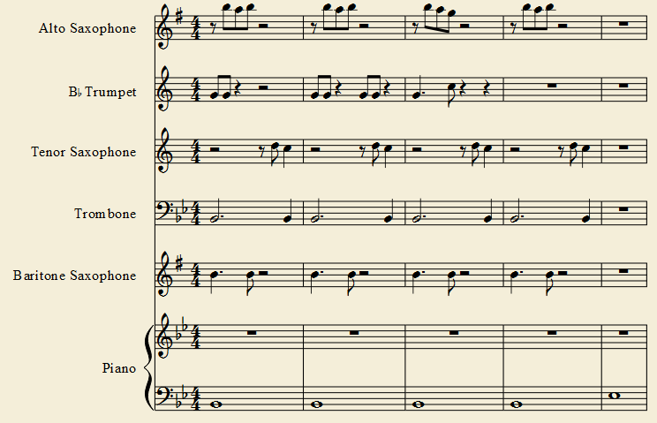
C Jam Blues Example:

Slide 4
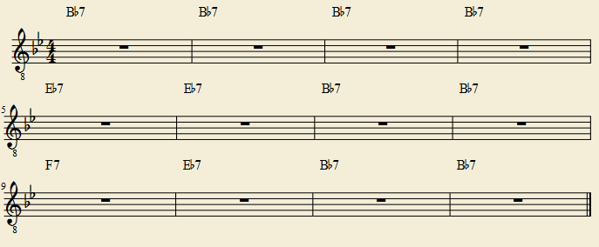
Now it’s YOUR turn:

