Slide 1
Improvisation
A little jazz..

Slide 2
Progressions
Roman numerals: I, ii, iii, IV, V, vi, vii, I
Works within a key
Movement by 5th, 3rd, 2nd
In all types of music
I
iii
IV
V
vi
ii
vii

Slide 3
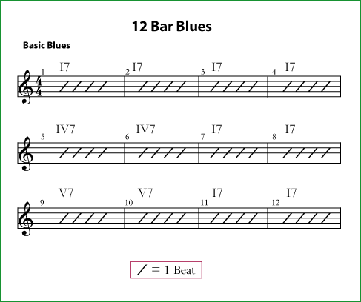
Blues Progression

Slide 4
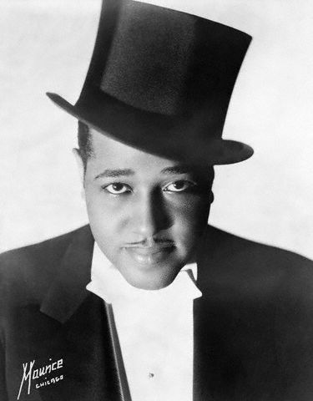
The Jazz Standard
A simple melody = “head”
Over a simple progression
Play the “head”, then solo

Slide 5
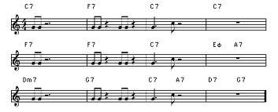
C Jam Blues

